Slide 1
Project Initiation

Slide 2
Major Topics
Project initiation
Determining project feasibility
Project scheduling
Managing project activities
Manage systems analysis team members

Slide 3
Project Planning Tasks
•
•
•
•
•
•
•
•
•
•
Describe project scope, alternatives, feasibility. Divide project into tasks.
Estimate resource requirements and create resource plan. Develop preliminary schedule.
Develop communication plan. Determine standards and procedures. Identify and assess risk.
Create preliminary budget. Develop a statement of work.
Set baseline project plan.

Slide 4
Project Initiation
Projects are initiated for two broad reasons:
Problems that lend themselves to systems solutions.
Opportunities for improvement through
Upgrading systems.
Altering systems.
Installing new systems.

Slide 5
Organizational Problems
Identify problems by looking for the following signs: Check output against performance criteria
Too many errors.
Work completed slowly.
Work done incorrectly.
Work done incompletely.
Work not done at all.
•

Slide 6
Organizational Problems (Continued)
Observe behavior of employees
High absenteeism.
High job dissatisfaction.
High job turnover.

Slide 7
Organizational Problems (Continued)
Listen to feedback from vendors, customers, and suppliers
Complaints.
Suggestions for improvement.
Loss of sales.
Lower sales.

Slide 8
Project Selection
Five specific criteria for project selection:
Backed by management.
Timed appropriately for commitment of resources.
It moves the business toward attainment of its goals.
Practicable.
Important enough to be considered over other projects.

Slide 9
Possibilities for Improvement
Many possible objectives exist including:
Speeding up a process.
Streamlining a process.
Combining processes.
Reducing errors in input.
Reducing redundant storage.
Reducing redundant output.
Improving system and subsystem integration.

Slide 10
Feasibility
A feasibility study assesses the operational, technical, and economic merits of the proposed project.
There are three types of feasibility:
Technical feasibility.
Economic feasibility.
Operational feasibility.

Slide 11
Technical Feasibility
Technical feasibility assesses whether the current technical resources are sufficient for the new system.
If they are not available, can they be upgraded to provide the level of technology necessary for the new system.

Slide 12
Technical Feasibility
Assessing the organization’s ability to construct the proposed system
Takes into account various project risk factors

Slide 13
Project Risk Factors
•
Project size
Team size, organizational departments, project duration, programming effort
Project structure
New vs. renovated system, resulting organizational changes, management commitment, user perceptions
Development group
Familiarity with platform, software, development method, application area, development of similar systems
User group
Familiarity with IS development process, application area, use of similar systems
•
•
•

Slide 14
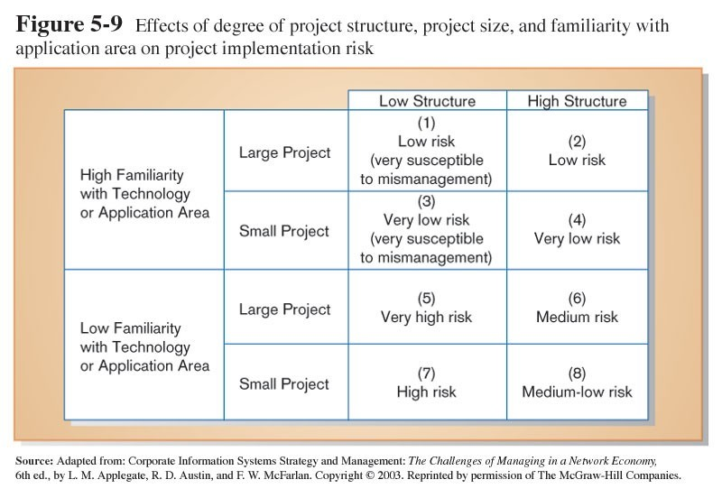
High technical familiarity mitigates risk due to project size and structure. Low familiarity increases risk.

Slide 15
Economic Feasibility
Economic feasibility determines whether the time and money are available to develop the system.
Includes the purchase of:
New equipment.
Hardware.
Software.

Slide 16
Economic Feasibility
Cost-benefit analysis: identify all the financial benefits and costs associated with a project
Tangible vs. intangible benefits
Tangible vs. intangible costs
One-time vs. recurring costs

Slide 17
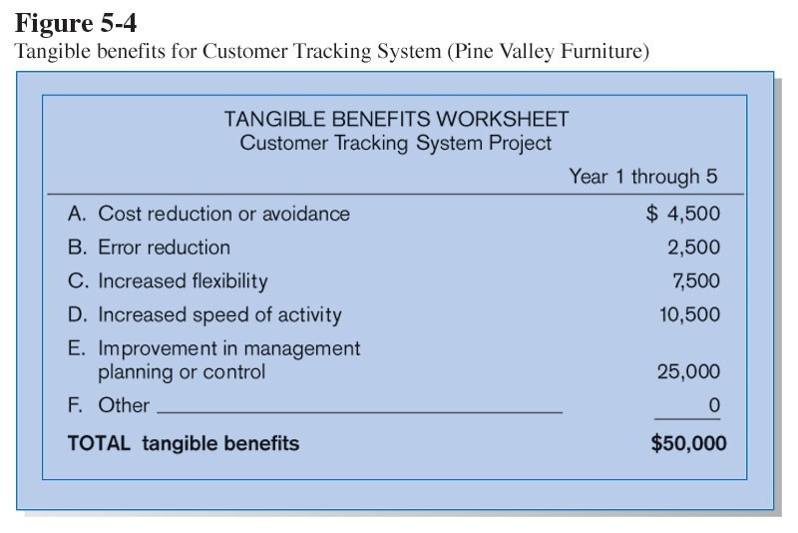
Tangible Benefits
Benefits that can be measured in dollars and with certainty

Slide 18
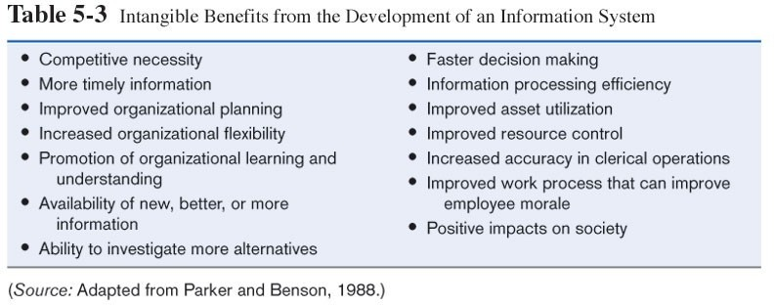
Benefits that cannot easily be measured in dollars or with certainty

Slide 19
Types of Costs
•
Tangible: can be measured in dollars and with certainty
Intangible: cannot easily be measured in dollars or with certainty
One-time: a cost associated with project start-up and development or systems start-up
Recurring: a cost associated with ongoing evolution and use of a system
•
•
•

Slide 20
Possible Project Costs
•
Procurement
Consulting, equipment, site preparation, capital, management time
Start-up
Operating systems, communications installation, personnel hiring, organizational disruption
Project-related
Application software, software modification, personnel overhead, training, data analysis, documentation
Operating
System maintenance, rental, asset depreciation, operation and planning
•
•
•

Slide 21
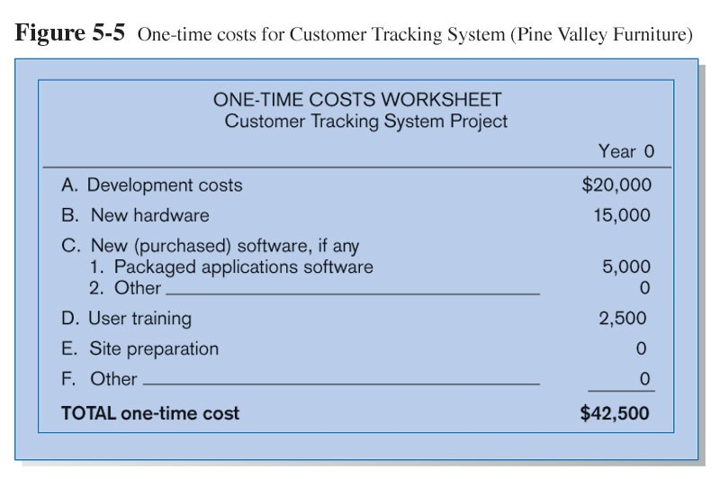
One-time Costs

Slide 22
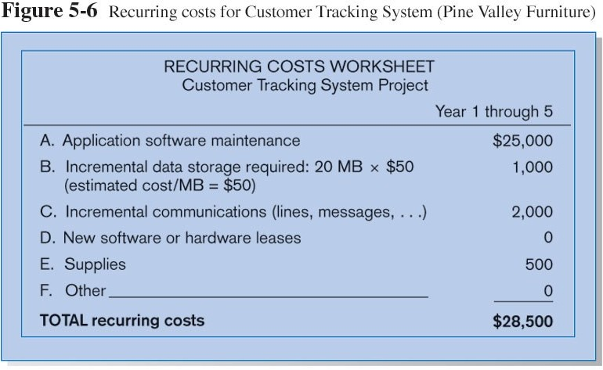
Recurring Costs

Slide 23
Three Financial Measurements for Economic Feasibility
Net Present Value (NPV)
Use discount rate to determine present value of cash outlays and receipts
Return on Investment (ROI)
Ratio of cash receipts to cash outlays
Break-Even Analysis (BEA)
Amount of time required for cumulative cash flow to equal initial and ongoing investment

Slide 24
Operational Feasibility
Operational feasibility determines if the human resources are available to operate the system once it has been installed.
Users that do not want a new system may prevent it from becoming operationally feasible.

Slide 25
Other Feasibility Concerns
Schedule
Can the project time frame and completion dates meet organizational deadlines?
Legal and Contractual
What are legal and contractual ramifications of the proposed system development project?
Political
How do key stakeholders view the proposed system?

Slide 26
Activity Planning
Activity planning includes:
Selecting a systems analysis team.
Estimating time required to complete each task.
Scheduling the project.
Two tools for project planning and control are Gantt charts and PERT diagrams.

Slide 27
Estimating Time
•
•
Project is broken down into phases.
Further project is broken down into tasks or activities.
Finally project is broken down into steps or even smaller units.
Time is estimated for each task or activity.
Most likely, pessimistic, and optimistic estimates for time may be used.
•
•
•

Slide 28
Gantt Charts
Easy to construct and use.
Shows activities over a period of time.

Slide 29
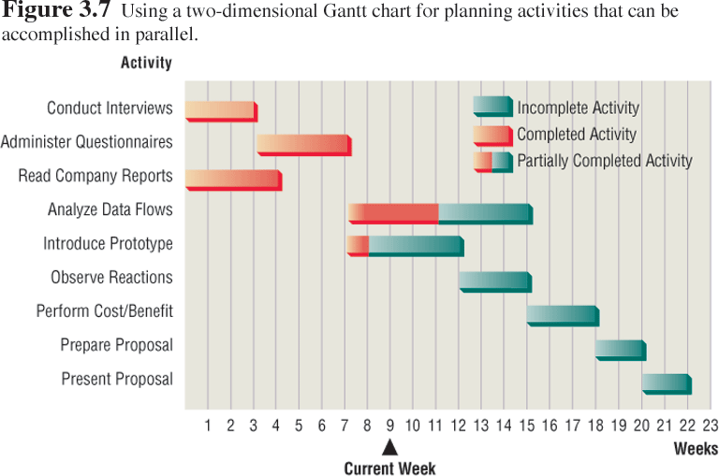
Gantt Chart Example

Slide 30
PERT Diagram
PERT-Program Evaluation and Review Technique
PERT diagrams show precedence, activities that must be completed before the next activities may be started.
Once a diagram is drawn it is possible to identify the critical path, the longest path through the activities.
Monitoring critical path will identify shortest time to complete the project.

Slide 31
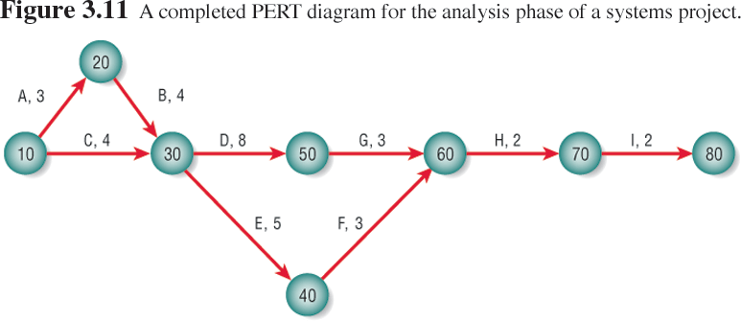
PERT Diagram Example

Slide 32
PERT Diagram Advantages
Easy identification of the order of precedence
Easy identification of the critical path and thus critical activities
Easy determination of slack time, the leeway to fall behind on noncritical paths

Slide 33
Timeboxing
Timeboxing sets an absolute due date for project delivery.
The most critical features are developed first and implemented by the due date.
Other features are added later.

Slide 34
Personal Information Manager Software
Personal information manager (PIN) software is useful for scheduling activities and includes features such as:
Telephone and fax number lists.
To-do lists.
Online calendars.

Slide 35
Team Management
Teams often have two leaders:
One who leads members to accomplish tasks.
One concerned with social relationships.
The systems analyst must manage:
Team members.
Their activities.
Their time and resources.

Slide 36
Goal Setting
Successful projects require that reasonable productivity goals for tangible outputs and process activities be set.
Goal setting helps to motivate team members.

Slide 37
Ecommerce Project Management
Ecommerce and traditional software project management differences:
The data used by ecommerce systems is scattered across the organization.
Ecommerce systems need a staff with a wide variety of skills.
Partnerships must be built externally and internally well ahead of implementation.
Security is of utmost importance.

Slide 38
Project Failures
Project failures may be prevented by:
Training.
Experience.
Learning why other projects have failed.

Slide 39
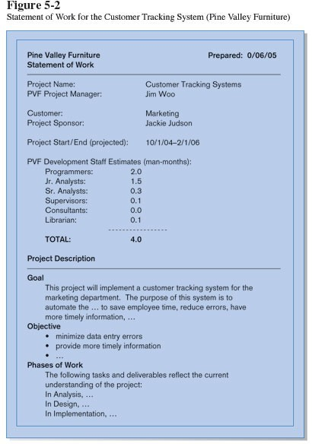
Statement of Work (SOW) is a “contract” between the IS staff and the customer regarding deliverables and time estimates for a system development project.

Slide 40
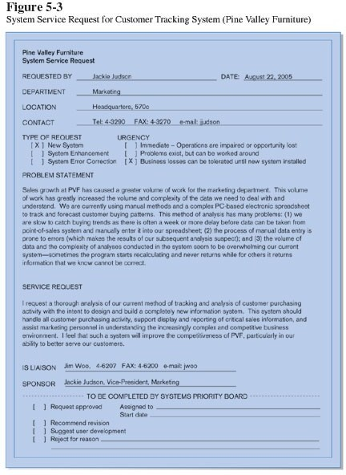
System Service Request (SSR) is a form requesting development or maintenance of an information system. It includes the contact person, a problem statement, a service request statement, and liaison contact information.

Slide 41
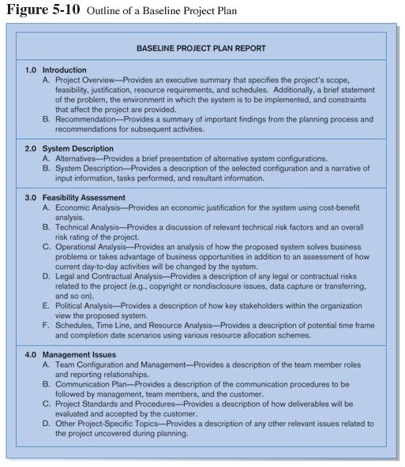
Baseline Project Plan (BPP) is a document intended primarily to guide the development team.
Sections: 4)Introduction 5)System
description 6)Feasibility
assessment 7)Management
issues

Slide 42
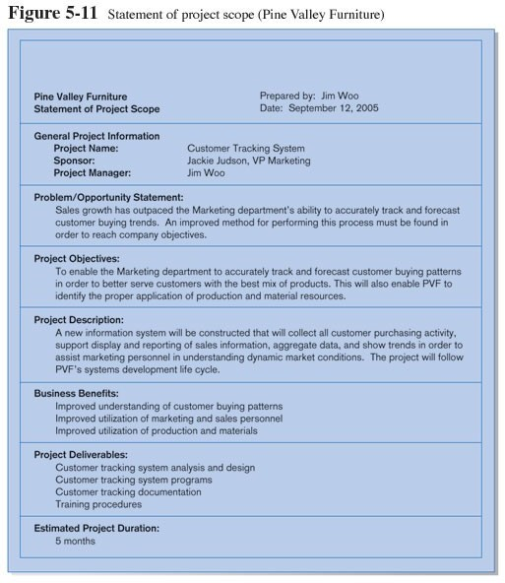
Project Scope statement is part of the BPP introduction.
Sections:
Problem
statement
Project objectives
Project
description
Business benefits
Deliverables
Expected duration

